Slide 1





Urban-alert
Make Your City Better. One Task at a Time.

Slide 2

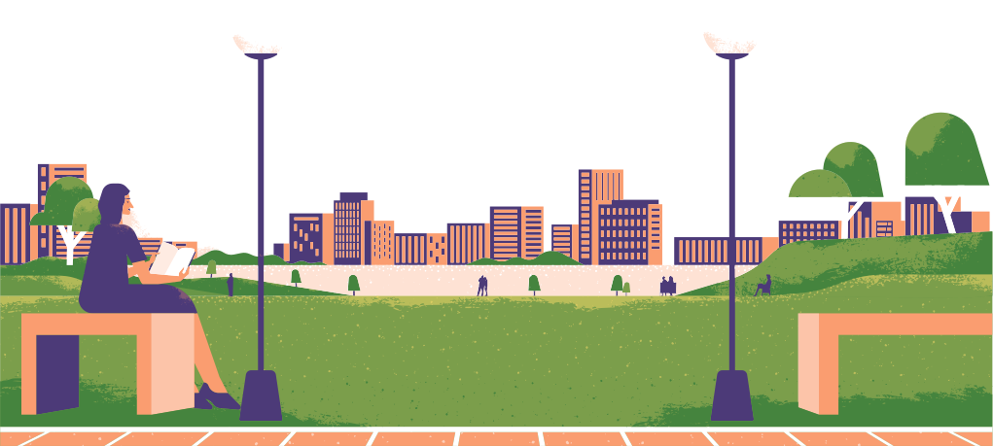
Why did we build this application?
We created this application to modernize the way local administrations collaborate with citizens. City halls often deal with numerous small, operational tasks that are important but difficult to prioritize due to limited staff or time. At the same time, many residents are willing to contribute if the process is simple, transparent, and rewarding. This app bridges that gap by providing a structured platform where the municipality can delegate certain tasks, and citizens can actively help improve their city.

Slide 3


TASKS IDEAS
The Urban Challenge
Collecting simple data (bikes, pedestrians, signage)
Checking environmental conditions (noise, air sensors, trash bins)
Helping at community events
Documenting urban elements (benches, green areas, street lighting)
What is the purpose of the application?
The main purpose is to streamline cooperation between the municipality and its residents. The application enables the city hall to publish clearly defined tasks and allows citizens to pick them up and complete them in exchange for rewards. Through gamification, we encourage civic participation in a way that feels engaging, meaningful, and beneficial to both sides.

Slide 4

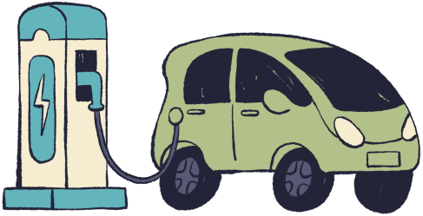
Why is the application a good idea?
Improves administrative efficiency by outsourcing simple, non-technical tasks to willing community members.
Strengthens civic engagement, enabling residents to directly contribute to the development of their city.
Uses gamification to create motivation and make civic involvement enjoyable.
Builds a stronger community by increasing transparency and cooperation between citizens and local government.
Optimizes public resources, helping the city address small but important tasks more quickly and at a lower cost.

Slide 5



Why doesn’t the application include a complaints or reporting system?
The app intentionally does not include a reporting/complaints feature because such a system already exists on the official website of the Timișoara Municipality. Our goal is not to duplicate existing tools, but to complement them.
While the municipality’s platform focuses on reporting issues, our application focuses on solving tasks that are formally delegated by the city and completed by citizens in a structured, rewarded way. The two systems work in parallel and serve different purposes.

Slide 6
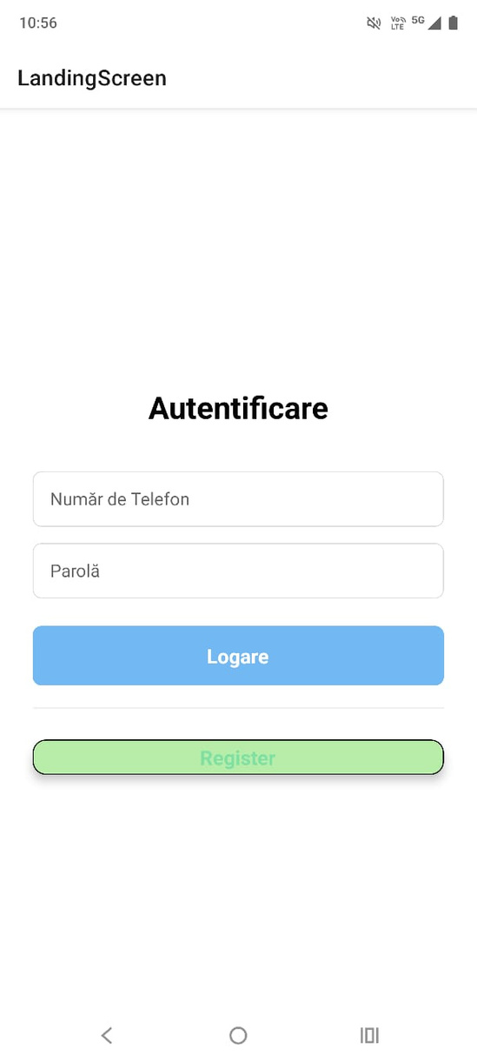
Explore the App
Authentication Screen
The first screen allows users to log in using their phone number. After entering the number, they receive a verification code to confirm their identity. This ensures secure and quick access to the app.

Slide 7
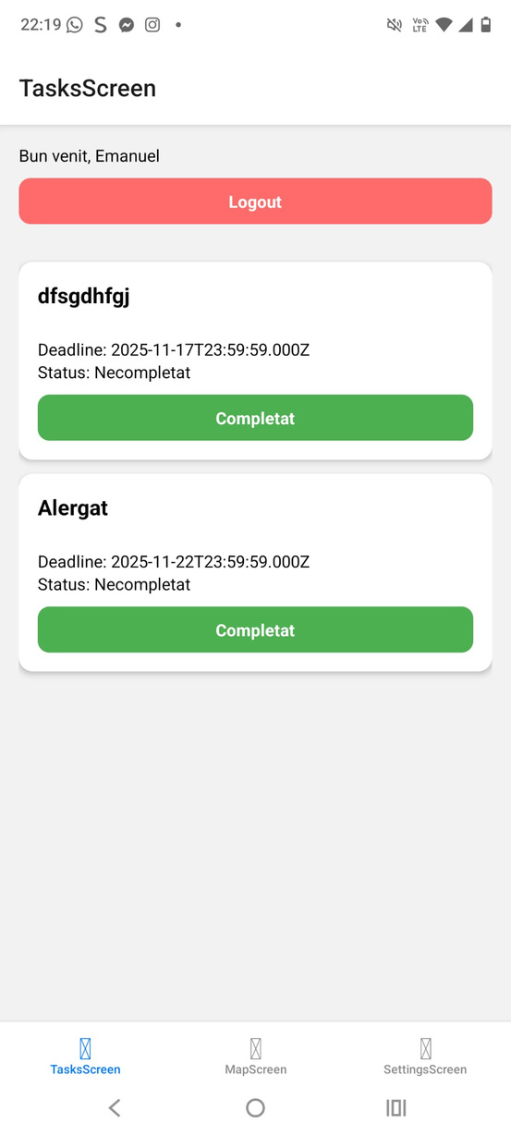
Explore the App
TaskScreen
Aduna Gunoi
Displays all available tasks published by the municipality. Users can see the task title, description, and location, and decide which ones to explore further—however, the rewards are not shown on this screen.
Planteaza copac

Slide 8
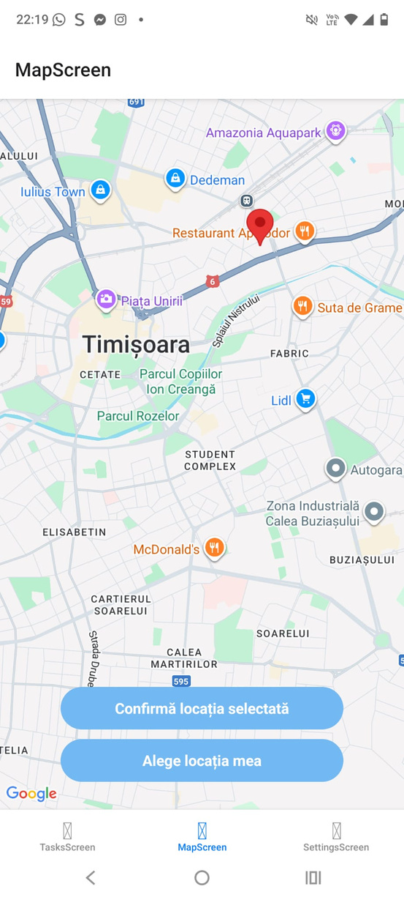
Explore the App
Map Screen
An interactive map of Timișoara showing the exact locations of all active tasks. Users can easily identify tasks nearby and navigate directly to them. It helps visualize task distribution across the city.

Slide 9
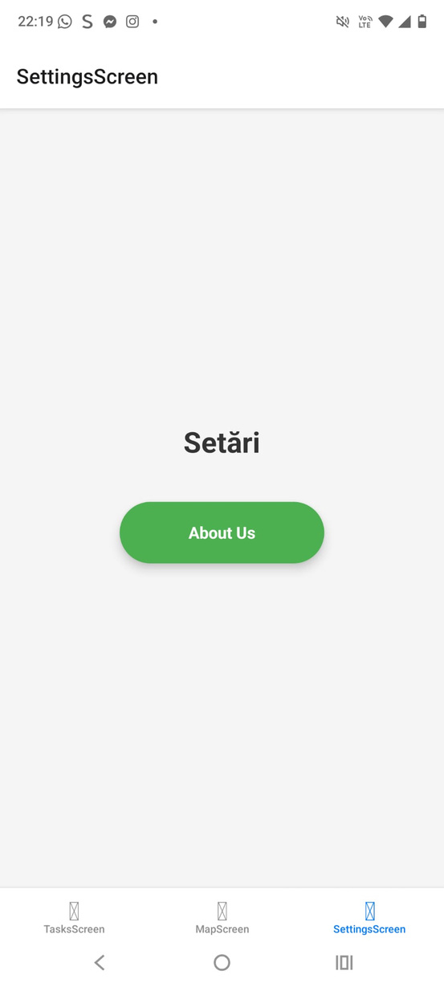
Explore the App
Settings Screen
A section where users can manage app preferences. From here, they can adjust basic settings and access the About Us page.

Slide 10
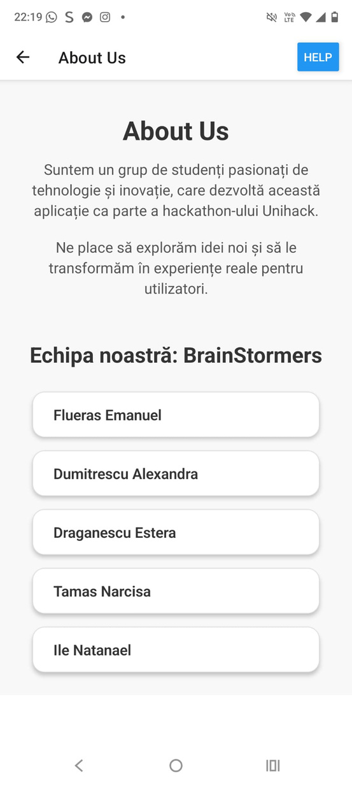
Explore the App
About Us Screen
This page introduces the team behind the application, explaining who created it, the mission of the project, and the vision that inspired its development.

Slide 11
Thank You So Much!
Make Your City Better. One Task at a Time.

